Slide 1
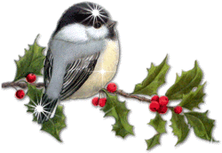
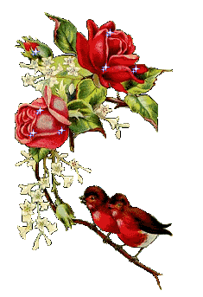
Lesson:
”Customs and traditions and foods of Kazakhstan”

Slide 2
The aim of the lesson:
The aims: 1. To introduce pupils the new words, to get information about traditional food in Kazakhstan and the names of national dishes, to teach pupils how to prepare it. To teach pupils to compare in Kazakhstan
2. To teach pupils to be attentive to each other
3.To develop the skills of speaking ,reading and writing on the theme.

Slide 3
Organization moment
I. Organization moment
T:Good morning ,students!
P:Good morning, teacher!
T:How are you!
P:I’m fine too .And you?
T:Who’s on duty today?
P:I’m on duty today.
T:Who is absent?
P:….. is absent.
T:What date is it today?
P:Today is the 14 th of January.
T:What weather like today? P:Today is the cloudy and cold .

Slide 4
Checking up the home task
1. Where is the UK of GB?
2. What its full name?
3. What is the Union Jack?
4. Who rules the UK?
5. Who is the Queen of the UK?
6. What is the capital of Kazakhstan?
7. What is the population of Kazakhstan?
8. What is museums of Kazakhstan do you know?
9. What do you know about Medeu?
10. Do you know British beliefs?
11. Do you know Kazakh beliefs?
12. What beliefs of other people do you know?

Slide 5

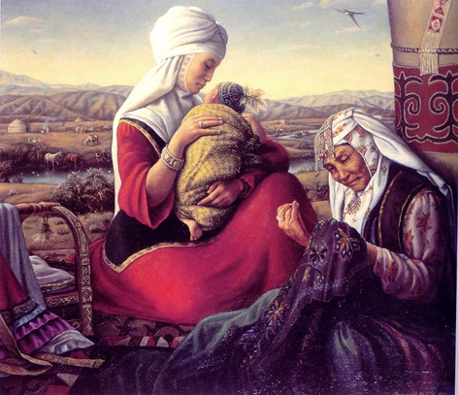
Kazakh superstitions and beliefs
A large number of Kazakh beliefs and superstitions can hardly be applied to modern life. The majority of them came from ancient times, even naturally become a part of today’s life, or, at least, can add a lot to our knowledge of Kazakh culture.

Slide 6
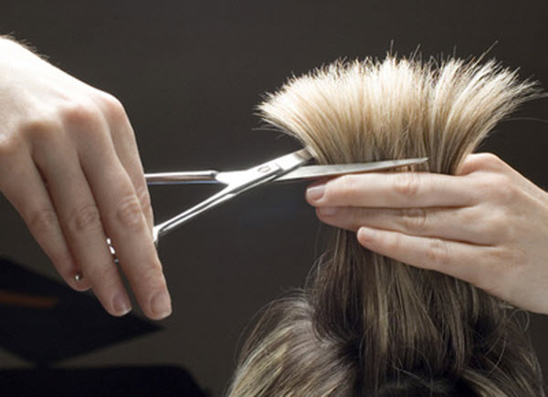
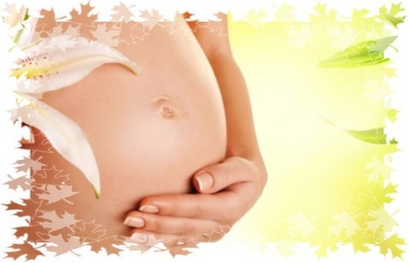
A pregnant woman cannot have a haircut because it may hurt her motherhood, and the happiness of the child she is having.

Slide 7
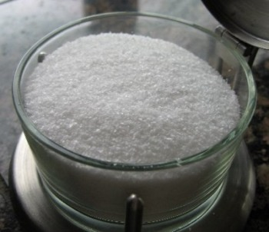
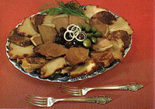
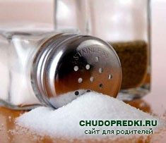
Kazakhs are always careful with salt. Food would be tasteless without salt.
Kazakh’s believe that “the essence of food is in its salt”.
Lives of those who have been careless with salt will become salty and bitter until the salt spilt by them dries out.

Slide 8
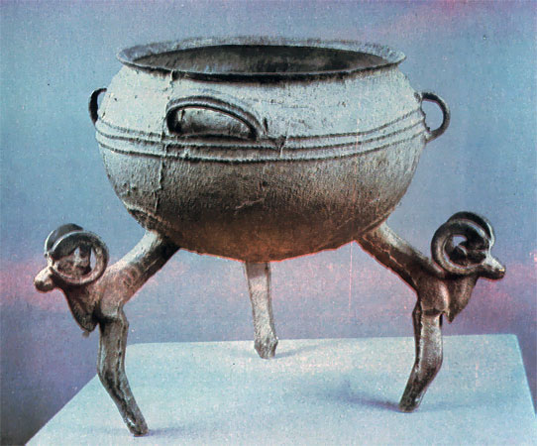
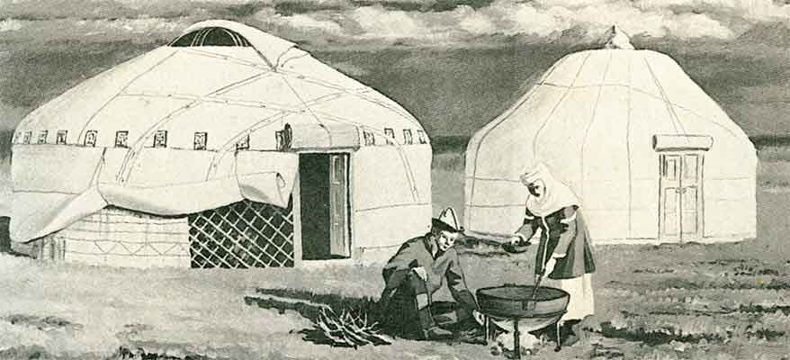
A cauldron/kazan can not be left facing the entrance door. It is bad luck if a cauldron slips and falls. It means your destiny is escaping , your very well-being is lost, food becomes scanty.

Slide 9
Answer the questions
Our traditional home cooked food is…….
Our favorite meat dishes are…
The Kazakh popular drinks are….
Kazakh people For guests usually prepare …

Slide 10
Vocabulary.
Custom –салт дәстур
uncovering brides face – келіннің бетін ашу
a veil – шымылдық
to introduce - таныстыру
a guest - қонақ
a bride groom – күеу жігіттің туысы
ancient - көне
respected - сыйлы
to bless – бата беру

Slide 11
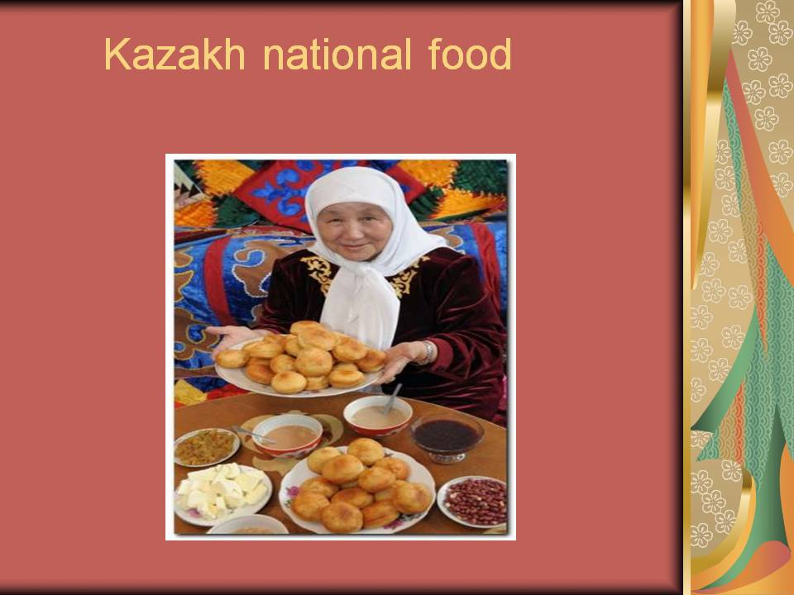
New lesson

Slide 12
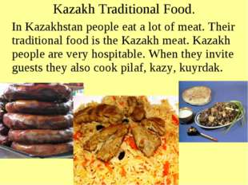

Slide 13
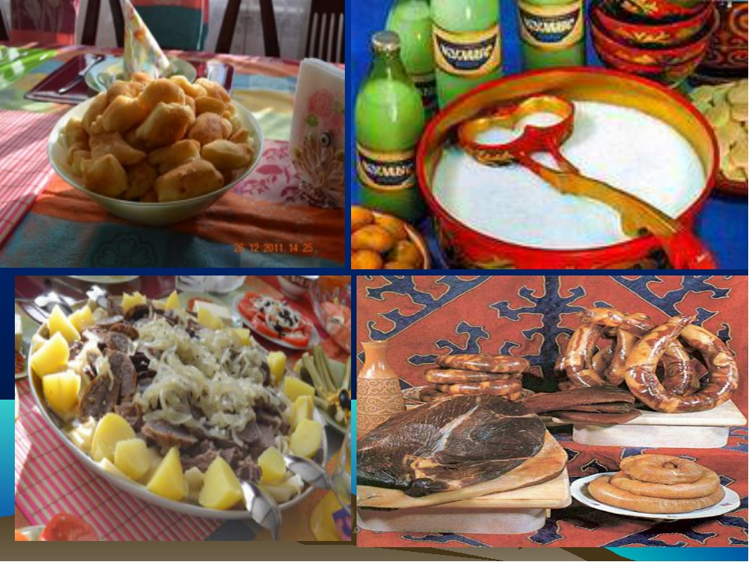

Slide 14
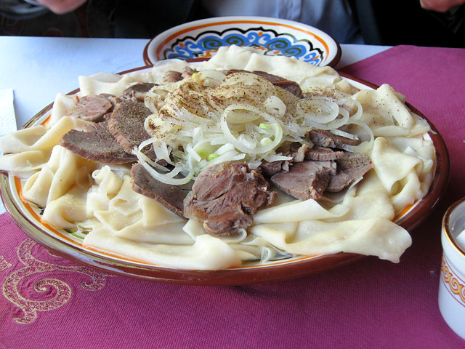
Beshbarmak

Slide 15
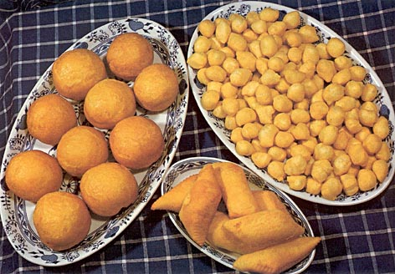
Baursak

Slide 16
KAZAKH NATIONAL GAMES

Slide 17
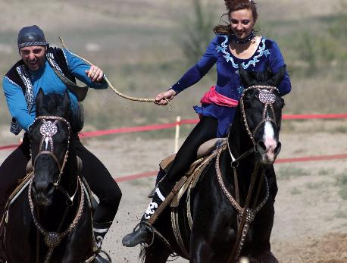
Kiz Kuu

Slide 18
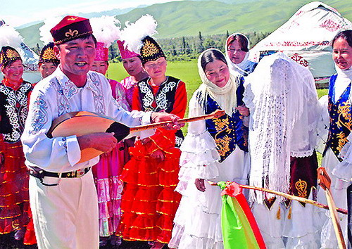
Betashar

Slide 19
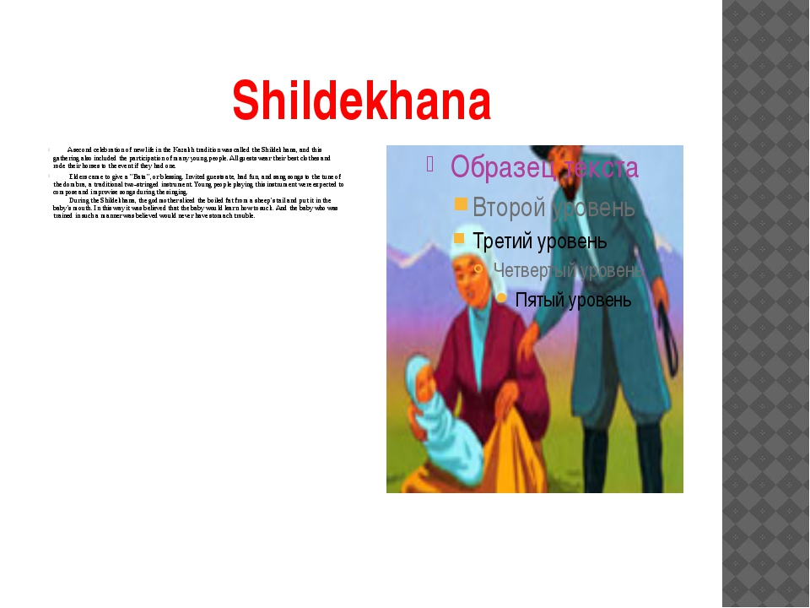

Slide 20
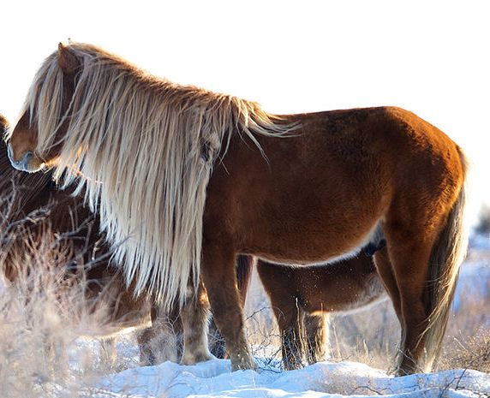
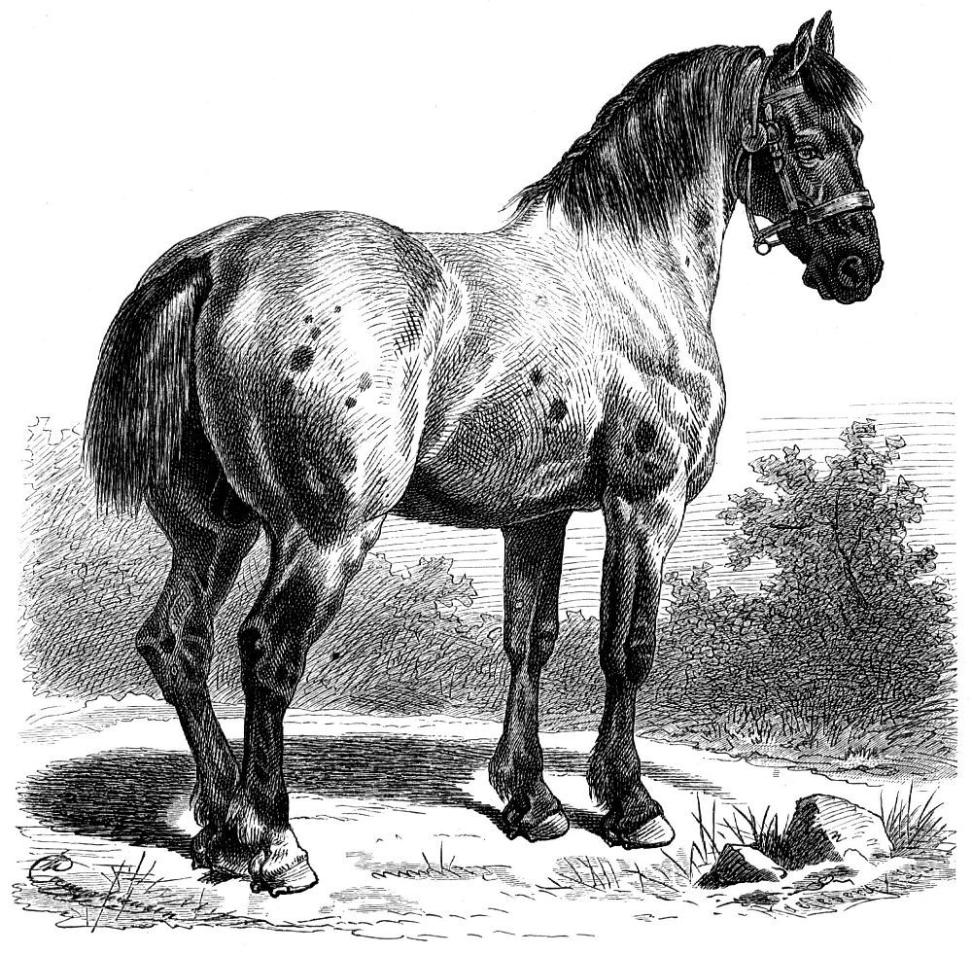
Usually, horse mains and tails are not trimmed, to make sure the horse’s owner enjoy good health.
When a horse owner dies, people will trim the mane and the tail of his horse to make it look mournful. Therefore, the Kazakh associate the trimmed mane and tails of their horses with mourning and death.

Slide 21
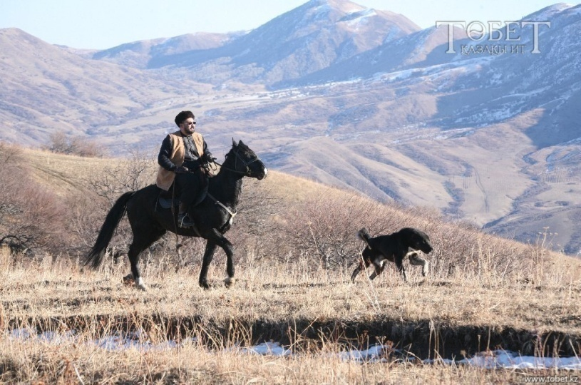
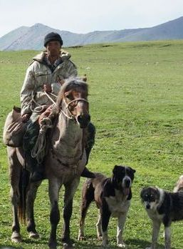
If a dog follows a horseman leaving his village, people would not try to force it back.
The dog is devoted to its owner, and if it wants to go with him it means he will have a happy trip.

Slide 22
The main national dish of Kazakhs is beshbarmak. Beshbarmak prepares from mutton, a horse - beef. Besbarmak - a dish eaten with five fingers. The sheep's head was for respected guests
Bauyrsak - national dish of Kazakhs, prepares from flour
The tastiest meats of the horse were zhal, zhaya, kazy, and karta.
Kazy - is a very dear and delicious meal karta - a large horse intestine which was very tasty when cooked.

Slide 23
Zhal - the layer of fat under a horse's mane. Zhal was another special portion of fat sliced especially for invited guests, to be served with kazy, a rump and
Zhaya - rump of a horse, this is very delicious;
Kurt - This is a product prepared by the process of pressing thick sour cream.

Slide 24
National drinks koumiss, shubat, airan.
Airan - sour milk - Kazakh used this winter and summer, cow's milk was given to kids
Shubat - fermented camel's milk - Shubat often served as a medicine.
Kymyz - were made of horse’s milk. Kymyz - This is a very useful for health.
Kaimak - sour cream. This is also made of milk

Slide 25
Milk was most used diary product.
Irimzhik - were made from boiled unskimmed milk and added sour cream. would be yellow.
Sary mai (butter) - Is made old milk
Suzbe and katyk - This is strained and thick sour milk it was another of the tasty diary products.

Slide 26
Grammar
Revision of modal verbs

Slide 27
Fill in the diagram about eating in Kazakhstan.
Traditional Food
Traditional games
Traditional drinks
Wedding ceremony

Slide 28
Defend the poster

Slide 29
True or false
1)Kazakh people present shapan to a noble or honored guest.
2)Kazakh girls cover their hair by wearing Kimeshek.
3)The camisole is an overcoat both for men or women.
4)The Takhia is a men’s everyday shoes.
5)Kebis is worn on head.
6)Tymak is made of animals fur.
7)Women’s camisole are more brightly coloured than men’s.

Slide 30
Home work
Write an essay about traditional food and games

Slide 31


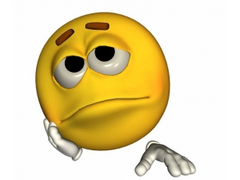
Reflection

Slide 32
Today you all have taken an active part in our lesson.
Our lesson is over. Good bye!

